Slide 1
File Systems
OPERATING SYSTEMS

Slide 2
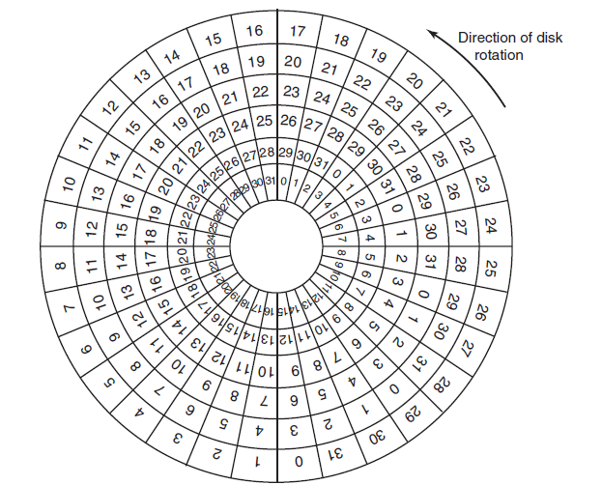
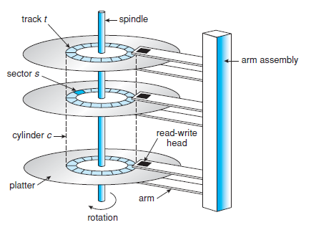
Magnetic Disks/Hard Disks Structure Overview
Provide the bulk of secondary storage for modern computer systems.
Store data permanently.
Hard disk architecture consists of:
Platter
Spindle
Read-write head
Track
Sector
Figure 2: An illustration of platter, tracks and sectors.
Figure 1: Moving-head disk mechanism.

Slide 3
Magnetic Disks/Hard Disks Structure Overview
Disk has multiple platters having circular shape like a CD.
Platters have 2 surfaces upper and lower. Both surfaces are being used.
All the platters are connected with a spindle.
Spindle rotates all platters together unidirectionally in a centric way either clockwise or anti clockwise.
When spindle moves all platters move together.
Actuator arms named read-write heads are connected with every platter.
Read-write heads are connected with both surfaces of platters. Which means a platter having upper and lower surfaces consists of two separate heads for two surfaces.

Slide 4
Magnetic Disks/Hard Disks Structure Overview (cont.)
Purpose of read-write heads is fetching data.
It moves back and forth (backward and forward) in order to read data. As separate heads are connected to every surfaces of a platter that means heads can read data from both surfaces.
Upper and lower both surfaces of a platters consist of same number of multiple tracks.
The outermost track is known as external track and the innermost is known as internal track.
If the heads requires to fetch data from an inner track from its current position, then it needs to move forward.
If the heads requires to fetch data from an outer track from its current position, then it needs to move backward.
Each track (both upper and lower surface) is divided into fixed number of multiple sectors.
Data is being stored in sectors.

Slide 5
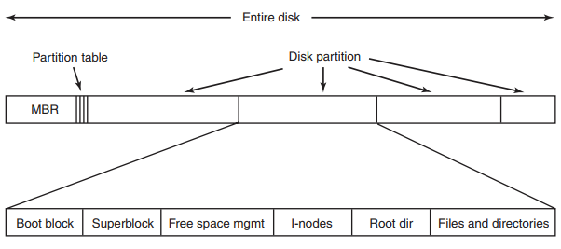
File System Concept
One of the major functionalities of OS.
It is a software component of OS which manages all files.
Different OS has different file systems.
Windows has NTFS, FAT32 etc. file systems, Mac OS has apple file system (AFS), Unix has unix file system (UFS), Linux has extended (ext) file systems etc.
It determines how user data in form of files gets stored in the secondary memory or disk permanently and how these data can be fetched from the disk.
Figure: A possible file-system layout.

Slide 6
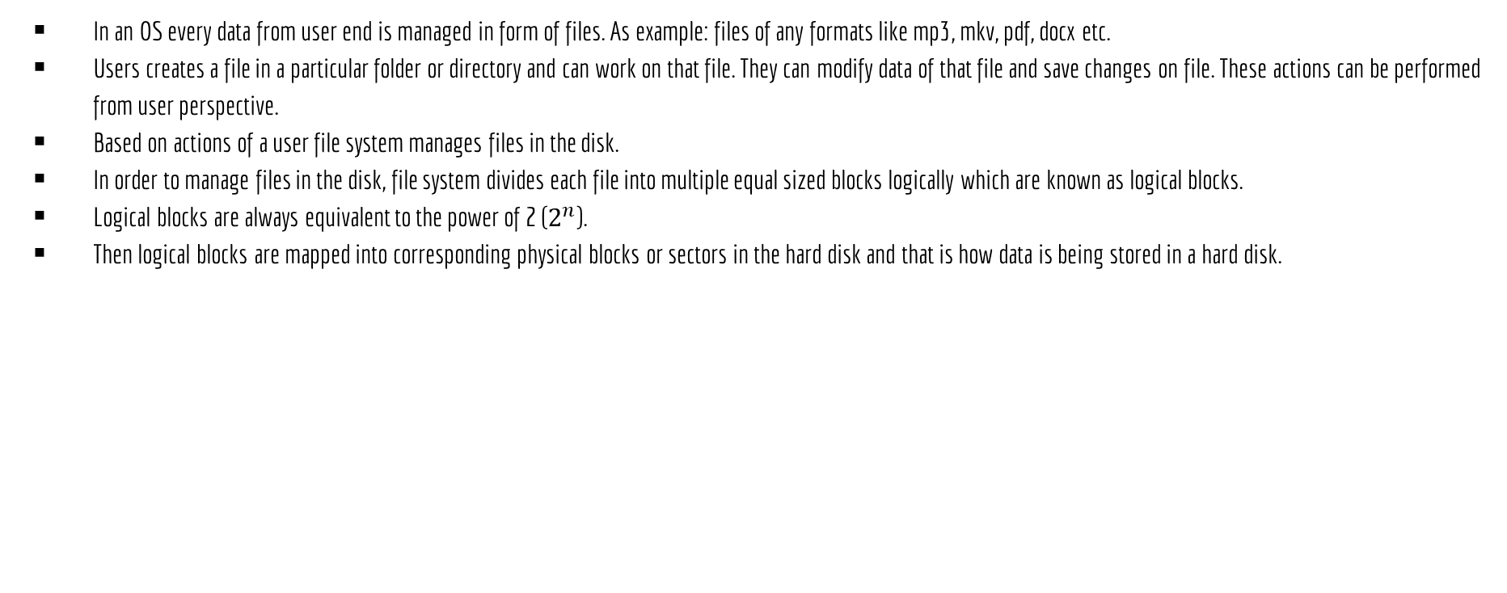
File System Concept (cont.)

Slide 7
File Attributes
Every file in the disk has a name and its data. In addition, all operating systems associate other information with each file, for example, the date and time the file was last modified and the file’s size. These information about the file is known as attributes of the file or metadata. The list of attributes varies considerably from system to system.
Information about files are kept in the directory structure, which is maintained on the disk.
Some of common attributes of files maintained by almost every OS are discussed below:
Name: The symbolic file name is the only information kept in human readable form.
Identifier: This unique tag, usually a number, identifies the file within the file system; it is the non-human-readable name for the file.
Type or Extensions: This information is needed for systems that support different types of files.
Location: This information is a pointer to a device and to the location of the file on that device.
Size: The current size of the file (in bytes, words, or blocks) and possibly the maximum allowed size are included in this attribute.
Protection: Access-control information determines who can do reading, writing, executing, and so on.
Time, date, and user identification: This information may be kept for creation, last modification, and last use. These data can be useful for protection, security, and usage monitoring.

Slide 8
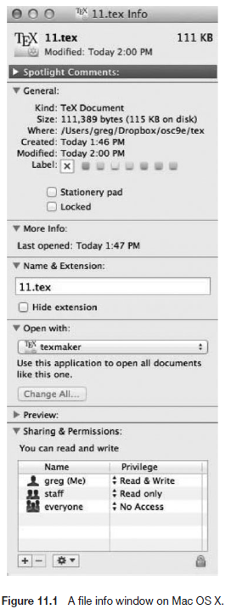
File Attributes

Slide 9
File Operations
Creating: Creates a file with all of its attributes or metadata.
Reading: Reads data from a file.
Writing: Edits or modifies a file.
Deleting: Removes a file alongside its all attributes.
Truncating: Removes information from a file. It does not remove attribute of the file.
Repositioning: Changes the position of the pointer within a file during IO operations.

Slide 10
File Allocation Methods
OPERATING SYSTEMS

Slide 11
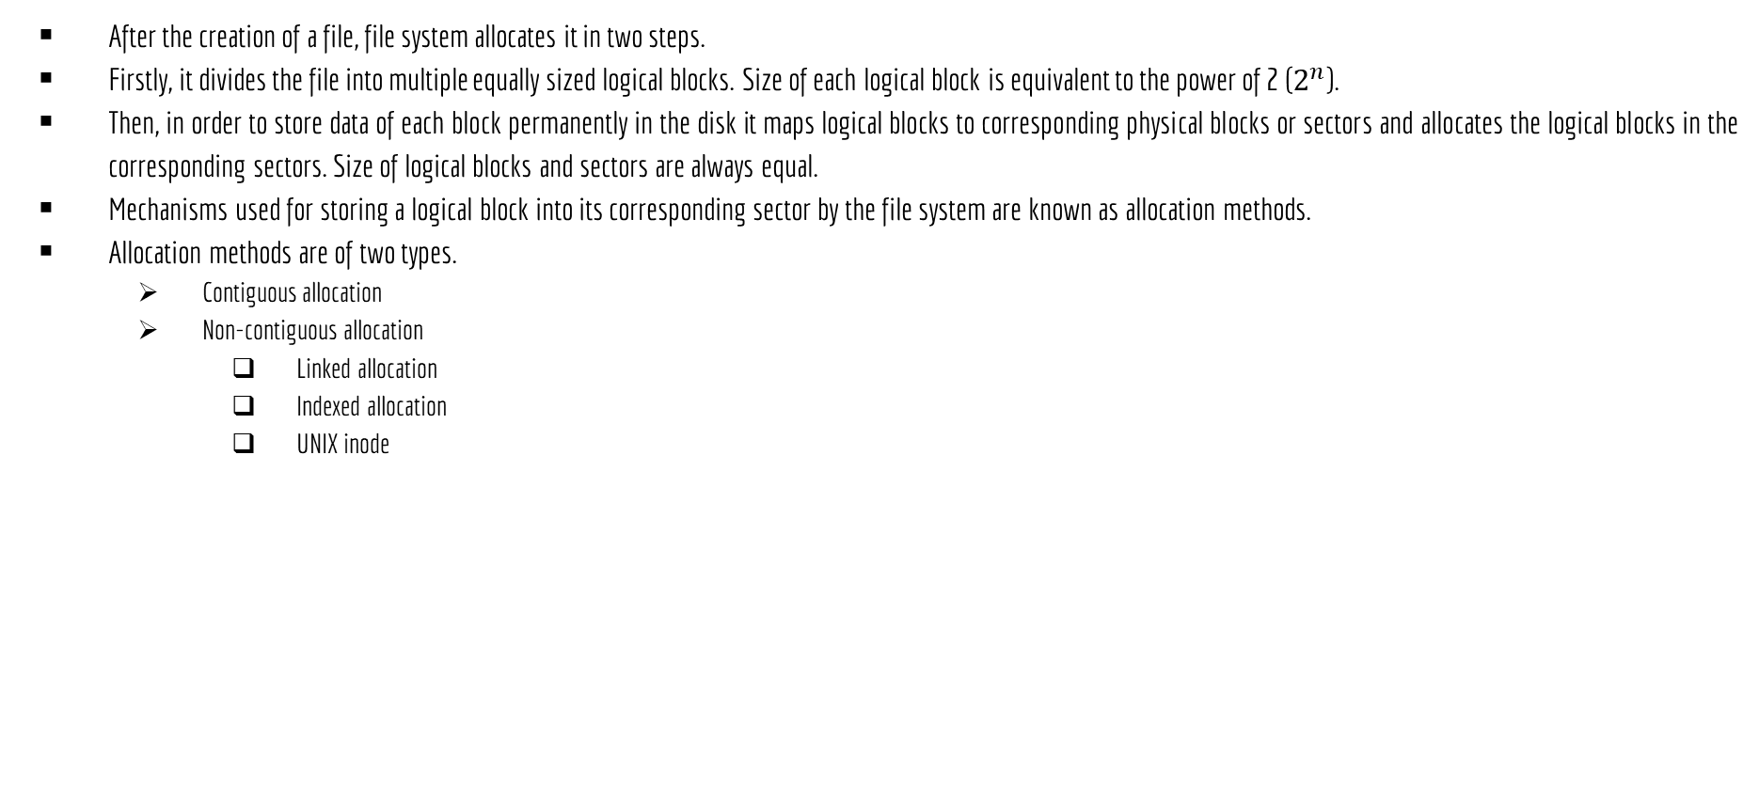
File Allocation Methods

Slide 12
Non-Contiguous Allocation
OPERATING SYSTEMS

Slide 13
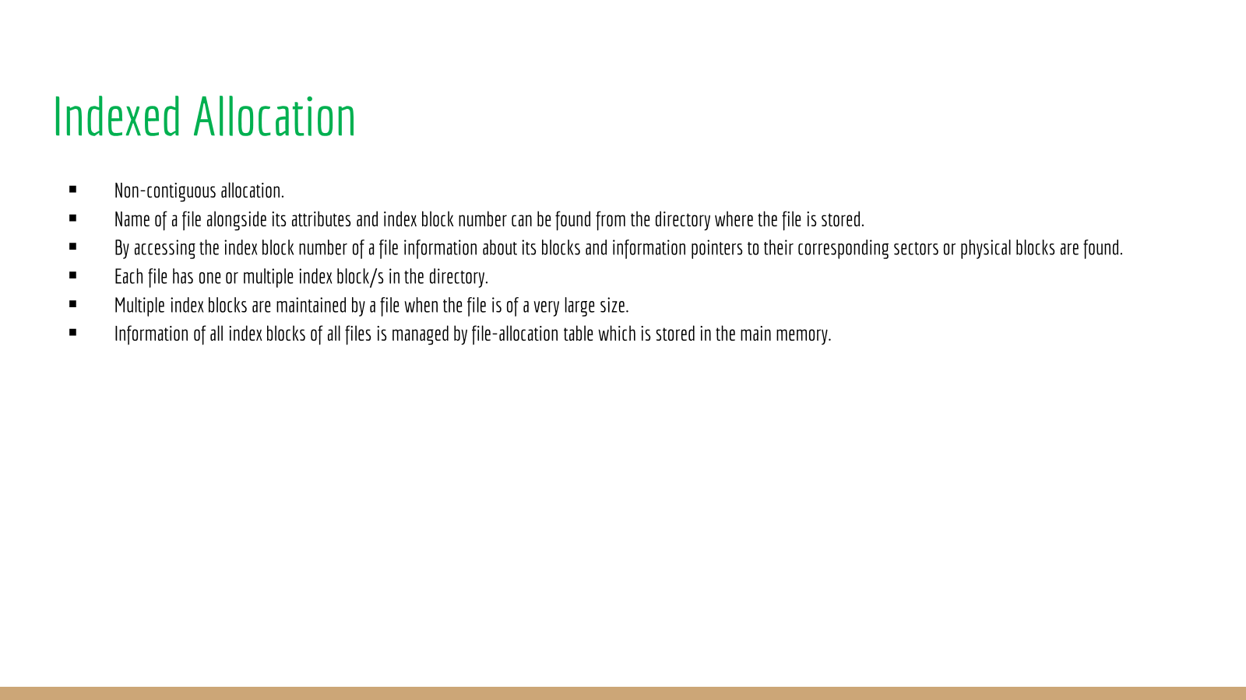

Slide 14
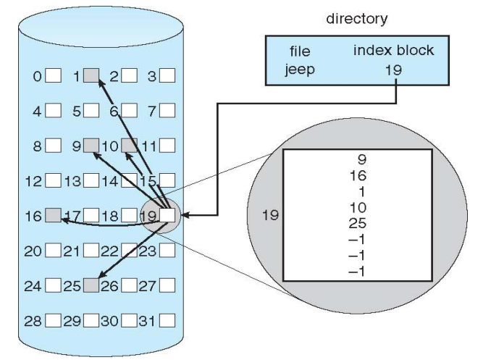
Indexed Allocation
Figure: Indexed allocation of disk space.

Slide 15
Indexed Allocation
Benefits:
Supports random or direct access.
No external fragmentations.
Drawbacks:
Pointer overhead.
Multilevel index when file is too large.

Slide 16
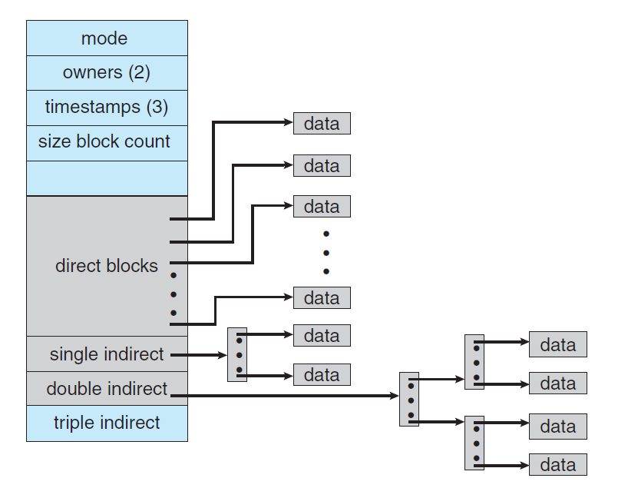
UNIX Inode
Variant of indexed allocation.
I means indexed and node means block.
It maintains multilevel index.
UNIX inode is a custom data structure consists of file attributes, direct blocks, single indirect, double indirect and triple indirect fields.
Direct blocks: Stores such data blocks where each block stores pointer to a block where data is stored.
Single indirect: Stores such data blocks where each block stores pointer to a direct block.
Double indirect: Stores such data blocks where each block stores pointer to a single indirect.
Triple indirect: Stores such data blocks where each block stores pointer to a double indirect.
Figure: The UNIX inode.

Slide 17
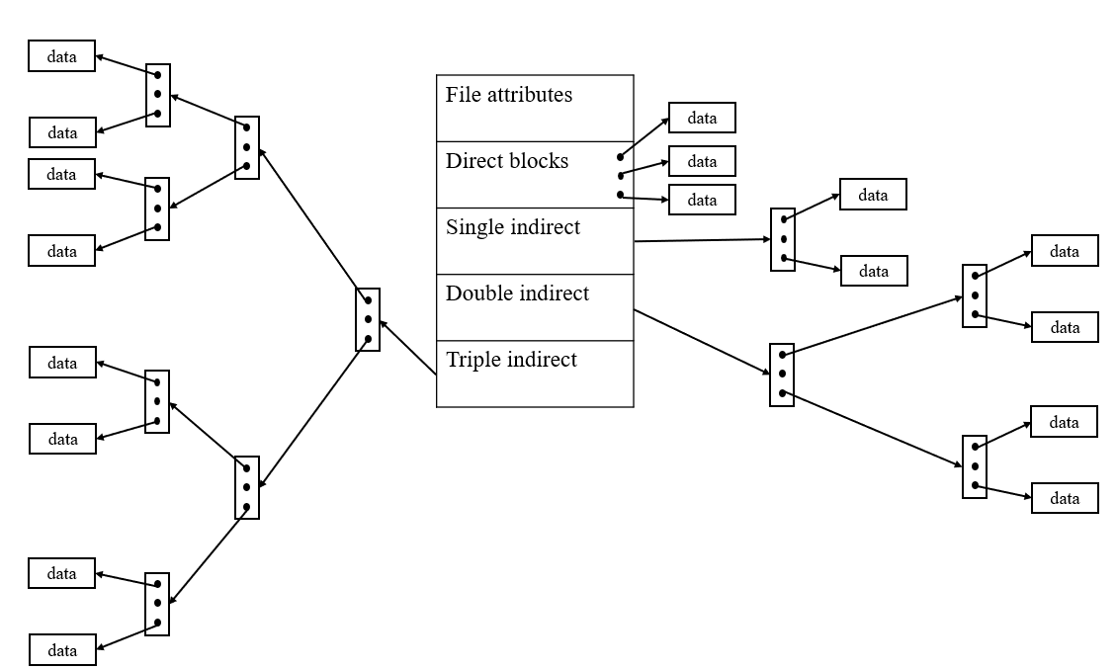
UNIX Inode
Figure: The UNIX inode with detailed triple indirect.

Slide 18
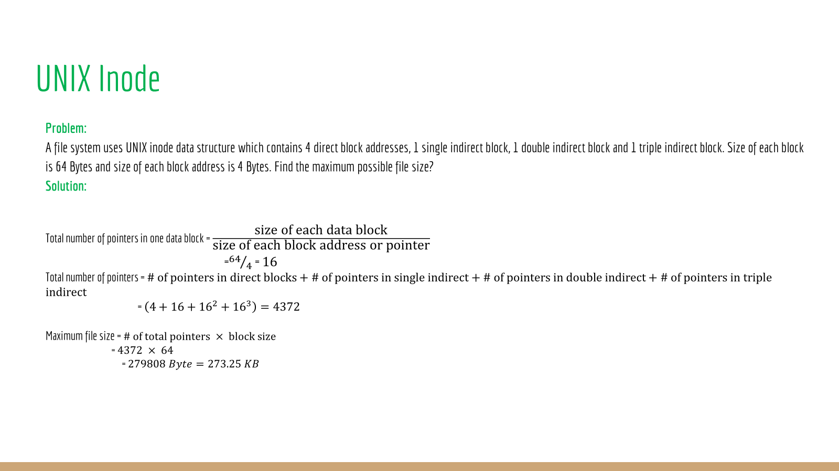

Slide 19
File System Implementation

Slide 20
The Way to Think
There are two different aspects to implement file system
Data structures
What types of on-disk structures are utilized by the file system to organize its data and metadata or file attributes?
Access methods
How does it map the system calls or operations made by a process as open(), read(), write(), etc.
Which structures are read during the execution of a particular system call?

Slide 21
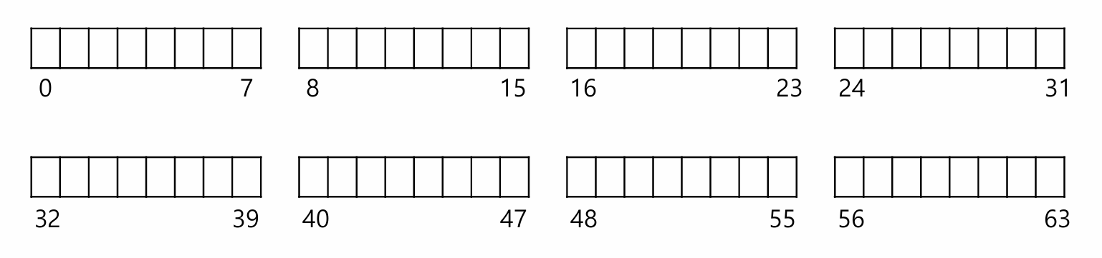
Overall Organization of VSFS (Very Simple File System [ext2])
Let’s develop the overall organization of the file system data structure.
Divide the disk into data blocks [data block numbers are logical or virtual addresses to the physical sectors].
Each block size is 4 KB.
The blocks are addressed from 0 to N -1.

Slide 22
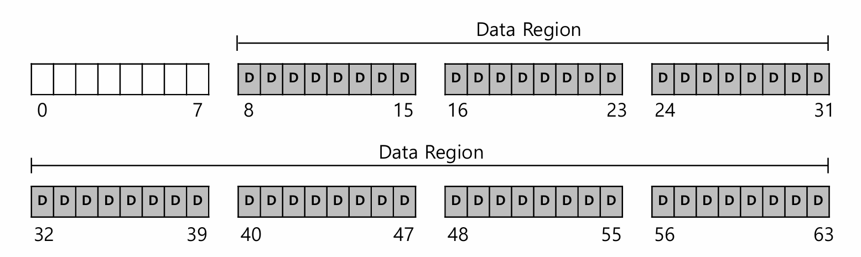
Data region in file system
Reserve data region to store user data
File system has to track which data block comprise a file, the size of the file, its owner, etc.
How we store these inodes in file system?

Slide 23
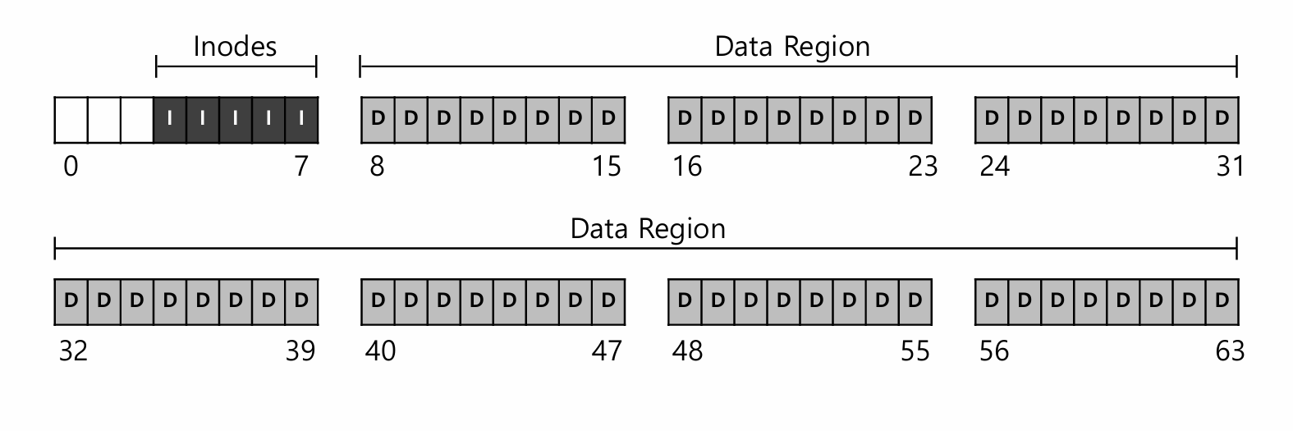
Inode table in file system
Reserve some space for inode table
This holds an array of on-disk inodes.
Ex) inode tables : 3 ~ 7, inode size : 256 bytes
4-KB block can hold 16 inodes.
The filesystem contains 80 inodes. (maximum number of files)

Slide 24
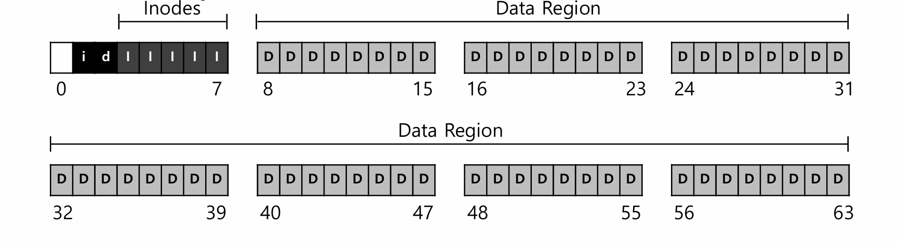
Allocation Structures
This is to track whether inodes or data blocks are free or allocated.
Use bitmap, each bit indicates free(0) or in-use(1)
data bitmap: for data region
inode bitmap: for inode table

Slide 25
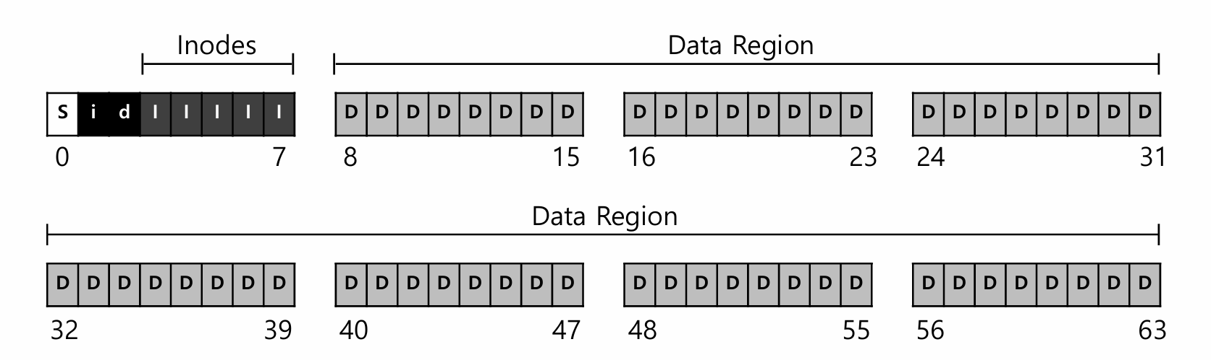
Superblock
Super block contains this information for particular file system or the metadata of the file system.
Ex) The number of inodes, begin location of inode table. etc
Thus, when mounting a file system, OS will read the superblock first, to initialize various information.

Slide 26
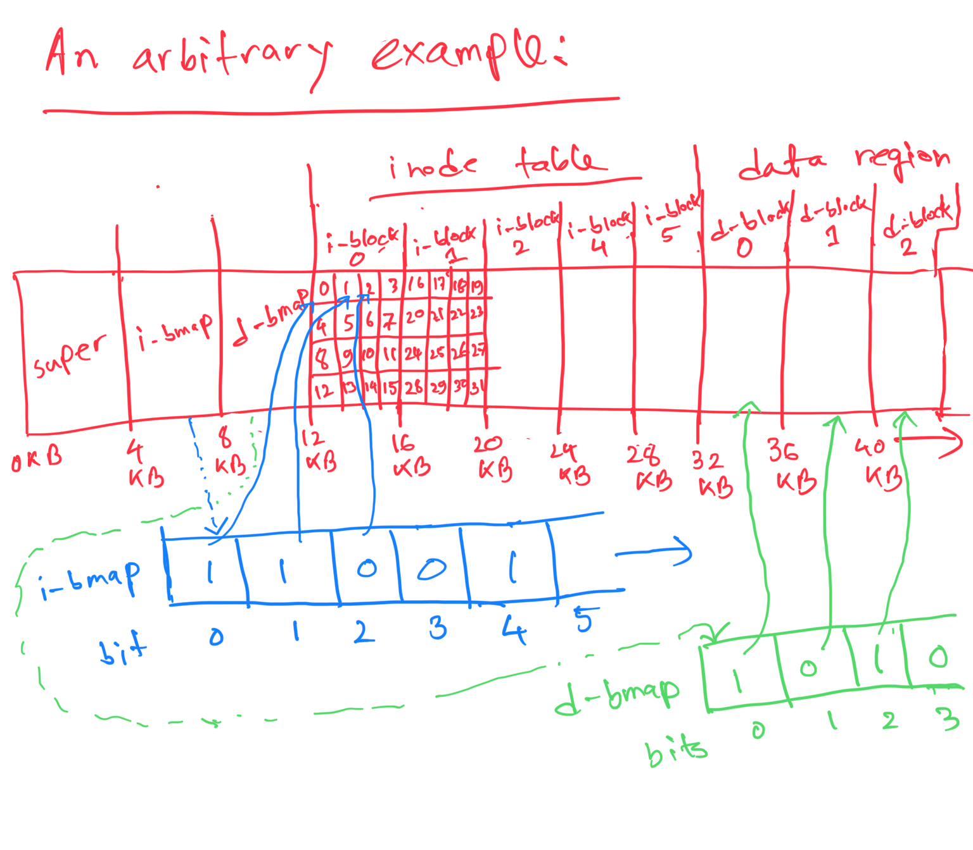
Dissection of the bitmaps of the file system (ext 2)

Slide 27
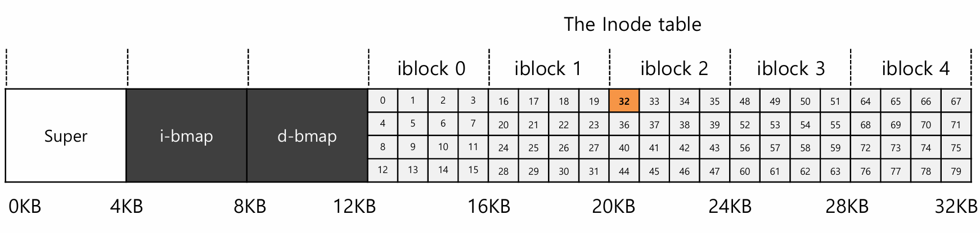
File Organization: The inode
Each inode is referred to by inode number.
by inode number, File system calculates where the inode is on the disk.
Ex) inode number: 32 and size of inode: 256 Bytes
Theorem for calculating the offset into the inode region = inode number * size of inode
Therefore, offset in this scenario = 32 * 256 = 8192
Byte address or location of the inode number = start address of the inode table + offset
Therefore, location of the inode number 32 = 12 KB + 8192 B = 12 KB + 8 KB = 20 KB
To read inode number 32, the file system would first calculate the offset into the inode region (32 sizeof(inode) or 8192), addit to the start address of the inode table on disk (inodeStartAddr = 12 KB), and thus arrive upon the correct byte address of the desired block of inodes : 20 KB.

Slide 28
File Organization: The inode
Disks are not byte addressable, sector addressable.
Disks consist of a large number of addressable sectors, (512 Bytes)
Ex) Fetch the block of inode (inode number: 32, size of inode: 256 Bytes, size of block: 4 KB)
Sector address is the physical address of the inode block:
block # = (inode number * sizeof(inode)) / blocksize = (32 * 256 B) / 4 KB = 8192 B / 4 KB = 8 KB / 4 KB = 2
sector address = (block # * block size) + inode table start address ) / sector size = {(2 * 4 KB) + 12 KB} / 512 B = 40

Slide 29
File Organization: The inode
inodes have all of the information or meta data or attributes of a file.
File type (regular file, directory, etc.),
Size, the number of blocks allocated to it.
Protection information(who owns the file, who can access, etc).
Time information.
Etc.

Slide 30
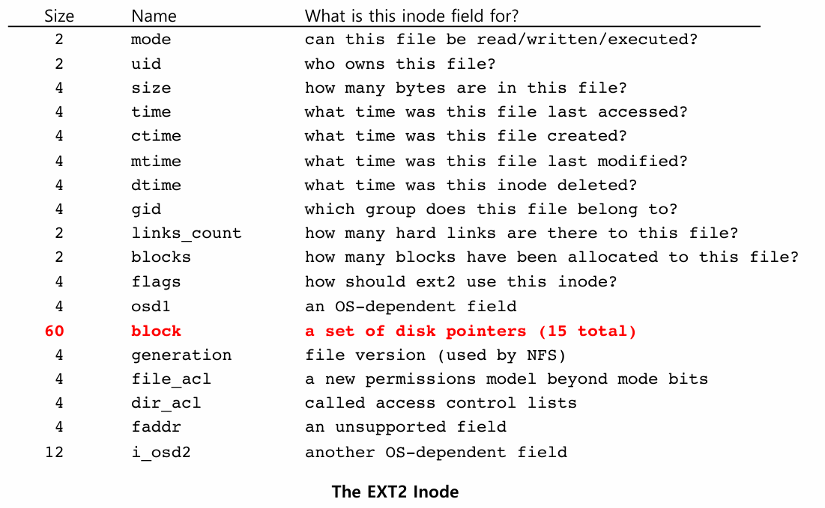
File Organization: The inode

Slide 31
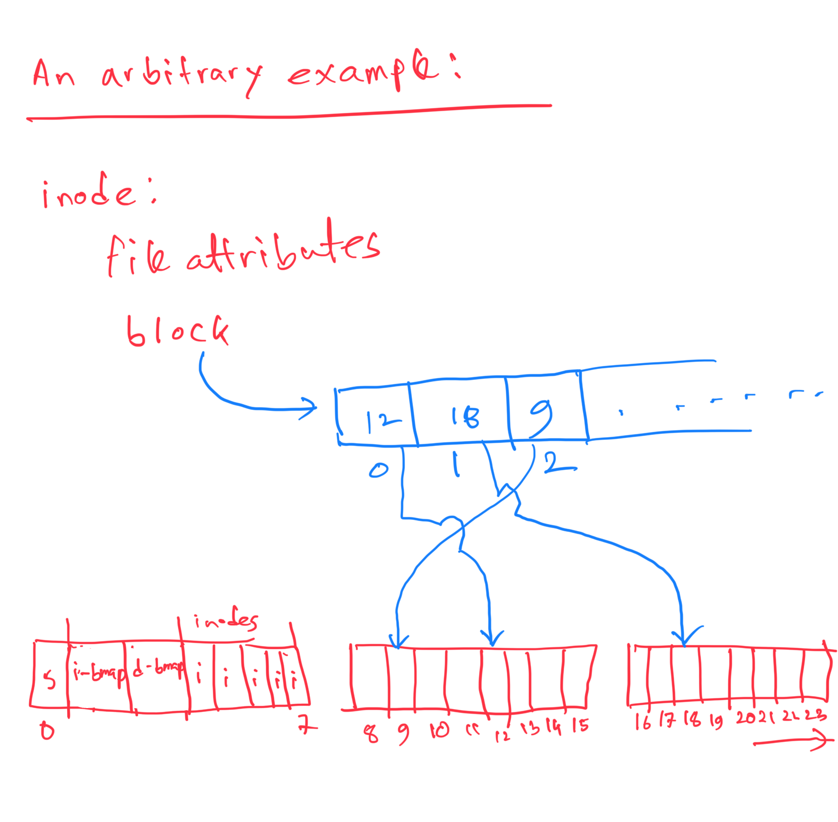
Dissection of the inode block field

Slide 32
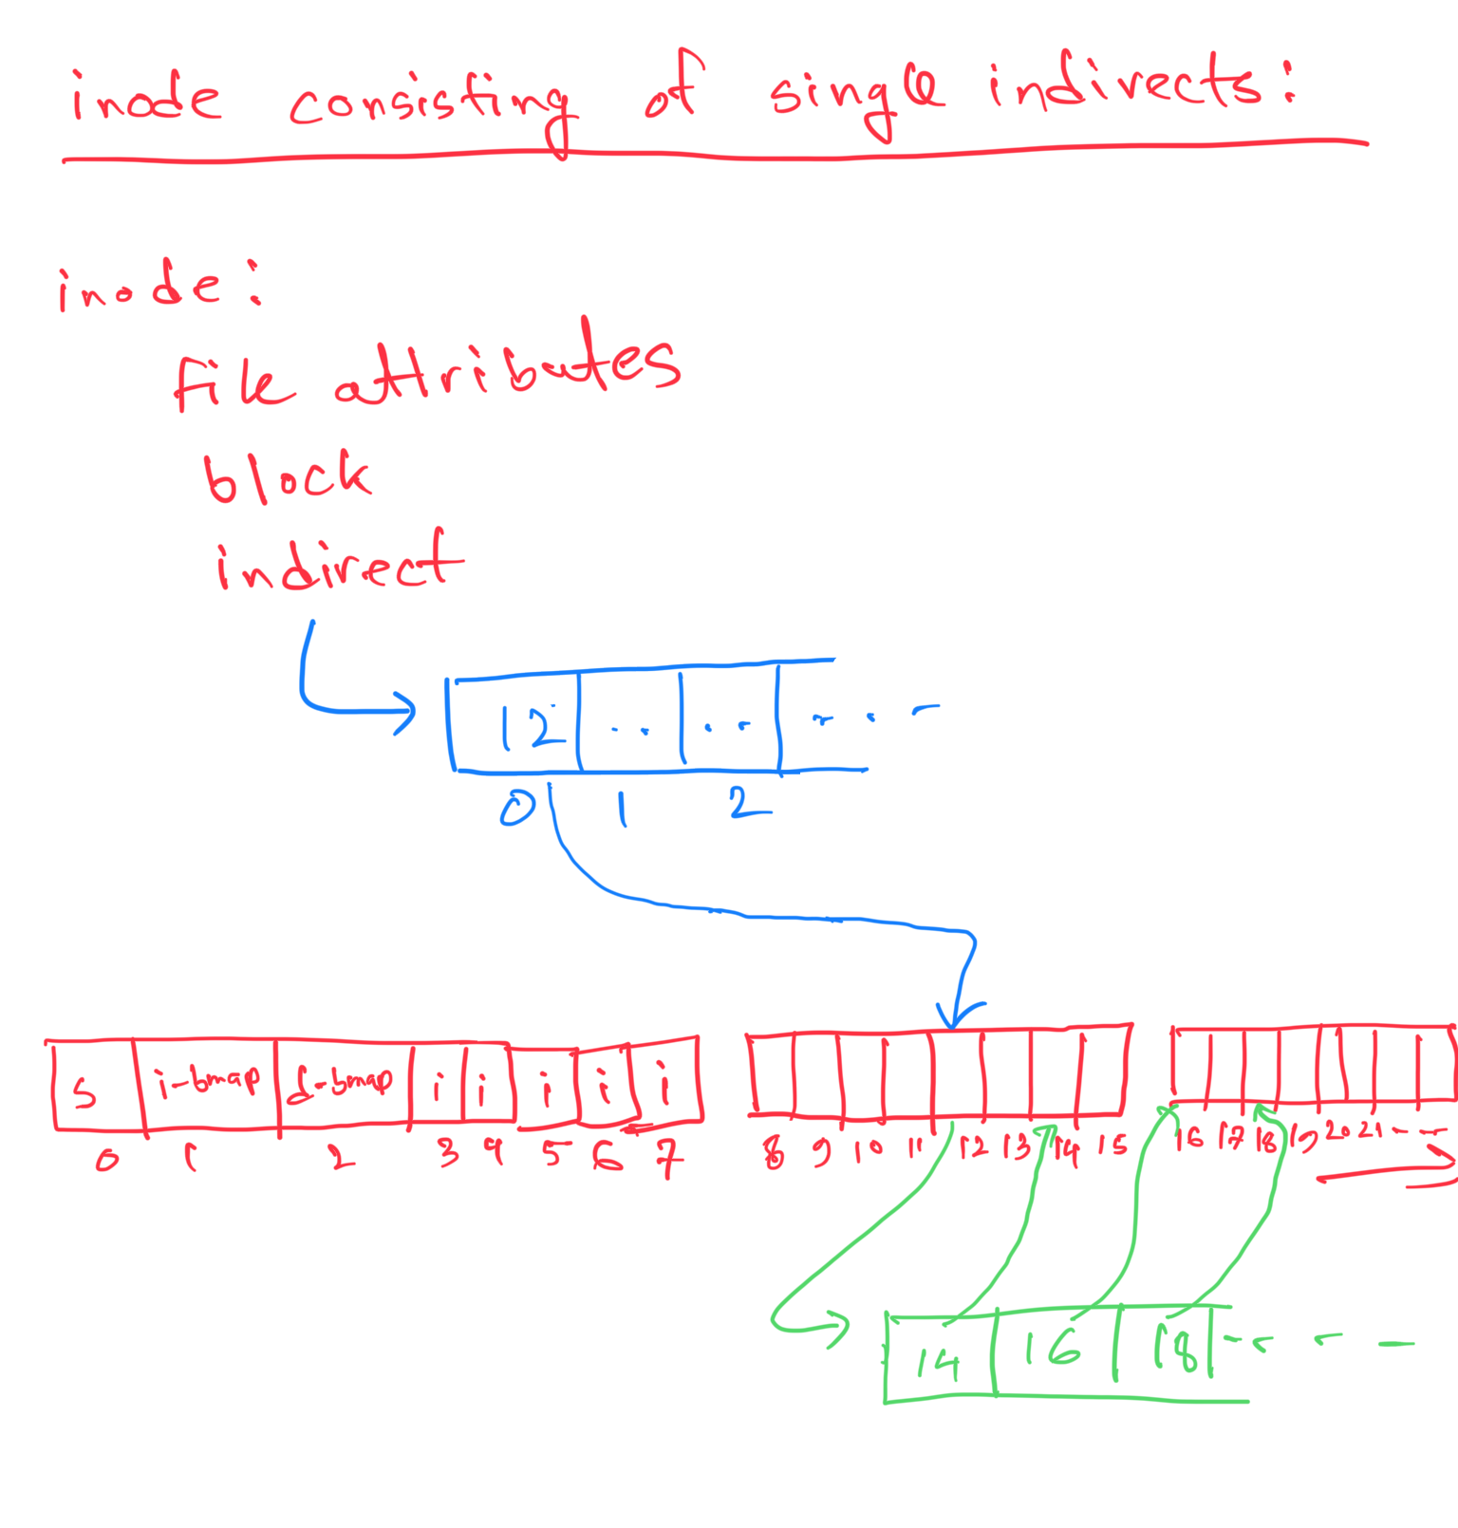
Dissection of the inode indirect

Slide 33
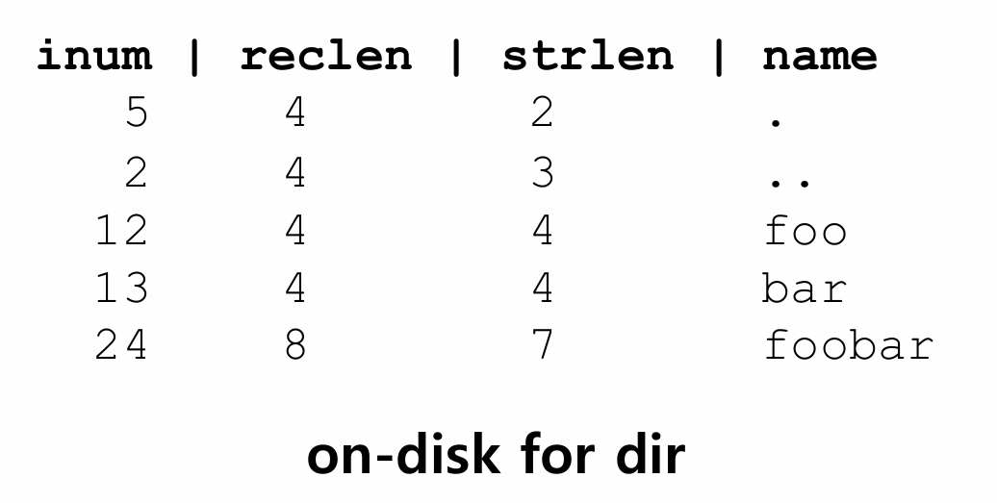
Directory Organization
Directory contains a list of (entry name, inode number) pairs.
Each directory has two extra files .”dot” for current directory and ..”dot-dot” for parent directory
For example, dir has three files (foo, bar, foobar)

Slide 34
Free Space Management
File system track which inode and data block are free or not.
In order to manage free space, we have two simple bitmaps.
When file is newly created, it allocated inode by searching the inode bitmap and update on-disk bitmap.
Pre-allocation policy is commonly used for allocate contiguous blocks.

Slide 35
Access Paths: Reading a File From Disk
Issue an open(“/foo/bar”, O_RDONLY)
Traverse the pathname and thus locate the desired inode.
Begin at the root of the file system (/)
In most Unix file systems, the root inode number is 2
Filesystem reads in the block that contains inode number 2.
Look inside of it to find pointer to data blocks (contents of the root).
By reading in one or more directory data blocks, It will find “foo” directory.
Traverse recursively the path name until the desired inode (“bar”)
Check finale permissions, allocate a file descriptor for this process and returns file descriptor to user.

Slide 36
Access Paths: Reading a File From Disk
Issue read() to read from the file.
Read in the first block of the file, consulting the inode to find the location of such a block.
Update the inode with a new last accessed time.
Update in-memory open file table for file descriptor, the file offset.
When file is closed:
File descriptor should be deallocated, but for now, that is all the file system really needs to do. No disk I/Os take place

Slide 37
Access Paths: Reading a File From Disk
Problem:
An existing file named “bar” needs to be read which is allocated in 3 data blocks.
Path of the file: “/foo/bar”
To read the file it was opened first by open() system call.
After opening the file read() system call was issued in the file to read the contents.
Illustrate the file access path timeline according to the scenario described above.

Slide 38
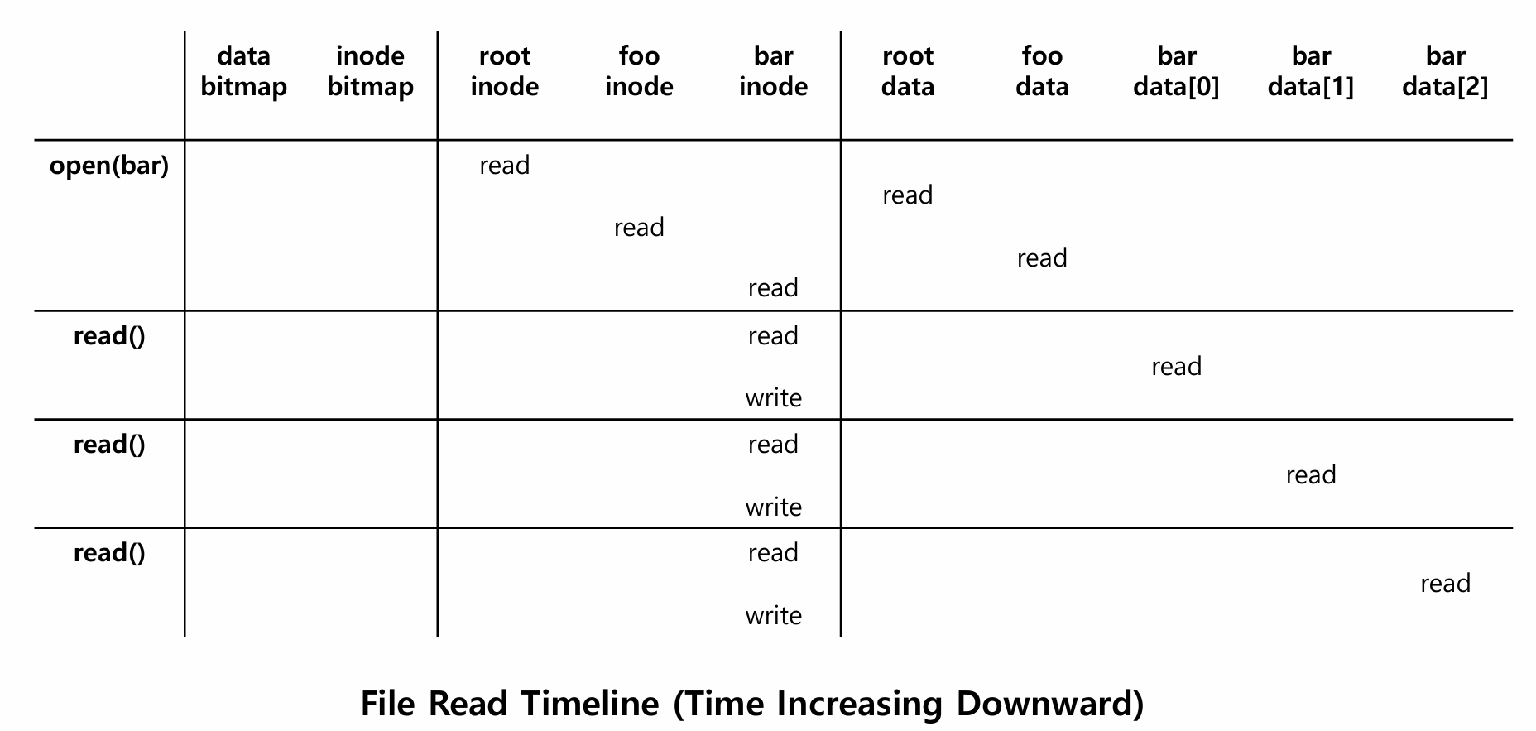
Access Paths: Reading a File From Disk
1
2
3
4
5
6
7
8
9
10
11
12
13
14

Slide 39
Access Paths: Writing to Disk
Issue write() to update the file with new contents.
File may allocate a block (unless the block is being overwritten).
Need to update data block, data bitmap.
It generates five I/Os:
one to read the data bitmap
one to write the bitmap (to reflect its new state to disk)
two more to read and then write the inode
one to write the actual block itself.
To create file, it also allocate space for directory, causing high I/O traffic.

Slide 40
Access Paths: Writing to Disk
Problem:
A file named “bar” has been created by create() system call.
Path of the newly created file: “/foo/bar”
After creating the file write() system call was issued in the file to write new contents and after the write operation the file has been allocated in 3 data blocks.
Illustrate the file access path timeline according to the scenario described above.

Slide 41
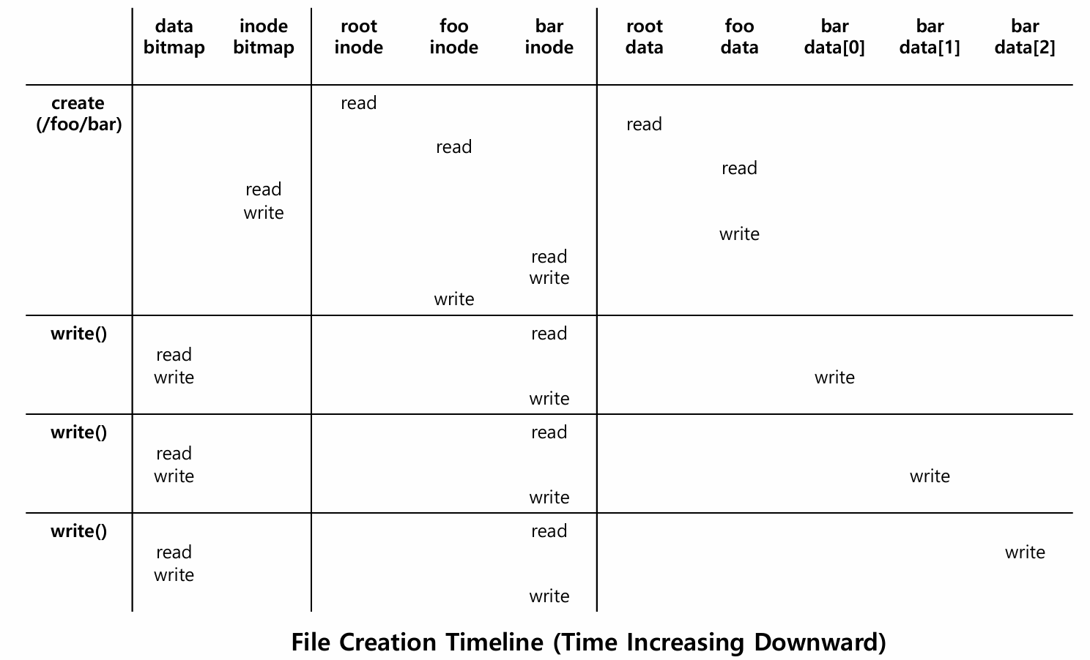
Access Paths: Writing to Disk
1
3
2
4
5
7
6
8
10
9
11
12
14
13
15
16
18
17
19
20

Slide 42
Crash Consistency and Journaling

Slide 43
Overview
File system data structures must persist.
files, directories, all of the other metadata ,etc
How to update persistent data structure?
If the system crashes or loses power, on-disk structure will be in inconsistent state.
In this chapter, we describe how to update file system consistently
Chapter 42 from this Book: https://www.dropbox.com/scl/fi/v44z7gtbacrqlxo71brra/Remzi-H.-Arpaci-Dusseau-Andrea-C.-Arpaci-Dusseau-Operating-Systems-Three-Easy-Pieces-2023.pdf?rlkey=77bvmf6k57mrr701tryc8tj0u&dl=0

Slide 44
An Example of Crash Consistency
Scenario
Append of a single data block to an existing file.
open() ⇒ lseek() ⇒ write() ⇒ close()
Inode
Bitmap
Data
Bitmap
Inodes
Data Blocks
 |  |  |  |  |  |  |  |  |  | I[v1] |  |  |  |  |  | Da
 |  |  |  | B [v1]
Before Append a single data block
Inode Bitmap represents the number of the Inode block (0, 1, …, 7 in this example) which is filled, 1 (shaded blox) indicates full, 0 empty (blank box)
Data Bitmap represents the number of the Data block (0, 1, …, 7 in this example) which is filled, 1 (shaded blox) indicates full, 0 empty (blank box)
B[v1] represents the first version of the data block, just one single data is added
I[v1] represents the the first version of the Inode where the Inode is data structure representing a file
Da represents a data

Slide 45
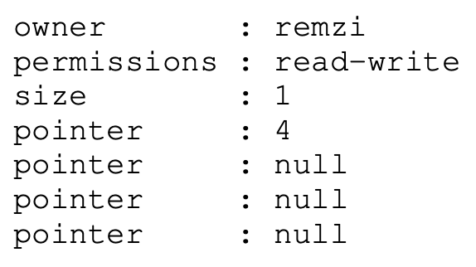
An Example of Crash Consistency
Scenario
Append of a single data block to an existing file.
Inode
Bitmap
Data
Bitmap
Inodes
Data Blocks
 |  |  |  |  |  |  |  |  |  | I[v1] |  |  |  |  |  | Da
 |  |  |  | B [v1]
Before Append a single data block

Slide 46
An Example of Crash Consistency (Cont.)
File system perform three writes to the disk.
Data bitmap is updated (B[v2])
Inode is updated (I[v2])
New Data block (Db) is added
Inode
Bitmap
Data
Bitmap
Inodes
Data Blocks
 |  |  |  |  |  |  |  |  |  | I[v2] |  |  |  |  |  | Da | Db
 |  |  |  |  | B [v2]
After Append a single data block

Slide 47
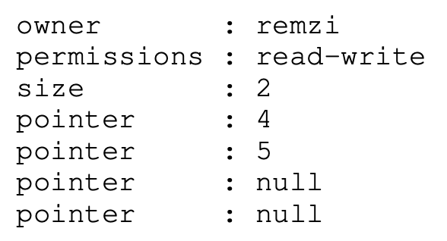
An Example of Crash Consistency (Cont.)
File system perform three writes to the disk.
inode I[v2]
Data bitmap B[v2]
Data block (Db)
Inode
Bitmap
Data
Bitmap
Inodes
Data Blocks
 |  |  |  |  |  |  |  |  |  | I[v2] |  |  |  |  |  | Da | Db
 |  |  |  |  | B [v2]
After Append a single data block

Slide 48
Crash Scenario
Only one of the below block is written to disk.
Data block (Db): lost update
Update inode (I[v2]) block: garbage, consistency problem
Updated bitmap (B[v2]): space leak
Two writes succeed and the last one fails.
The inode(I[v2]) and bitmap (B[v2]), but not data (Db).: consistent from the system’s metadata
The inode(I[v2]) and data block (Db), but not bitmap(B[v2): inconsistent
The bitmap(B[v2]) and data block (Db), but not the inode(I[v2]): inconsistent
Crash-consistency problem (consistent-update problem)

Slide 49
Solution
The File System Checker (fsck)
fsck is a Unix tool for finding inconsistencies and repairing them.
super block*: if the number of blocks in the filesystem is larger than the filesystem size. If the block is corrupted, the corrupted block is replaced by an alternate copy of the superblock.
free blocks: scans the inodes, indirect blocks, double indirect blocks. Goal is to make sure the file system metadata is internally consistent.
inode state: check if the state of each inode is valid (Ex: valid type file, directory, symbolic link, etc.). If there are problems with the inode fields that are not easily fixed. The inode is considered suspect and cleared by fsck.
inode link: check if the reference count for each inode is consistent
check if a block is shared by the two inodes.
check for “bad” block pointer: ”bad” block pointer is the one that points to the location that lies outside the filesystem partition.
directory: Check if . and .. are properly set up. Make sure that there are only one hard link for a directory.
*Super block contains this information for particular file system w Ex) The number of inodes, begin location of inode table. etc

Slide 50
Drawbacks of FSCK
Building a working fsck requires complex knowledge of the file system.
fsck have a bigger and fundamental problem: too slow
scanning the entire disk may take many minutes or hours.
Performance of fsck became prohibitive.
As disk grew in capacity.

Slide 51
Solution
Journaling (or Write-Ahead Logging)
Before overwriting the on-disk structures in place, write down a little note on the disk, describing what you are to do.
Writing this note is the “write ahead”. The structure that is the destination of the “write ahead” is called log. hence, This is Write-Ahead Logging.

Slide 52
Journaling
File system reserves some small amount of space within the partition or on another device.
Super | Group 0 | Group 1 | … | Group N
without journaling
Super | Journal | Group 0 | Group 1 | … | Group N
with journaling

Slide 53
Data Journaling
Lets’ update a file (appending a data block to a file). Following structures are updated.
inode (I[v2]), bitmap (B[v2]), and data block (Db)
First, Journal write: write the transaction as below.
TxB: Transaction begin block (including transaction identifier)
TxE: Transaction end block
others: contain the exact contents of the blocks
physical logging
Journal
TxB | I[v2] | B[v2] | Db | TxE
Transaction

Slide 54
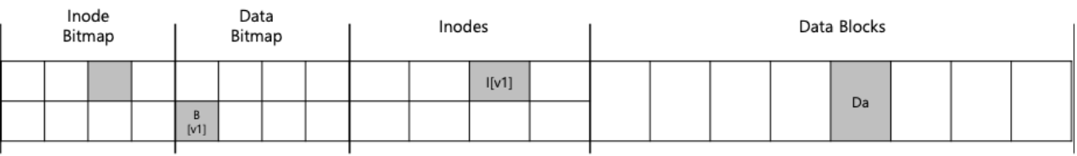
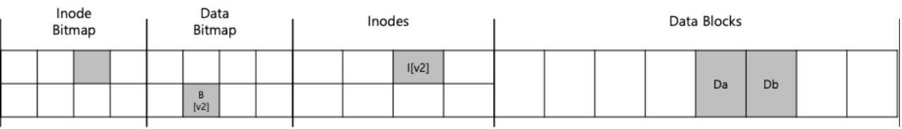
Data Journaling (Cont.)
Second, Checkpoint: Write the physical log to their original disk locations.
checkpoint physical logging
Journal
TxB | I[v2] | B[v2] | Db | TxE
Transaction
Transaction

Slide 55
Crash during Data Journaling
Wat if a crash occurs during the writes to the journal?
physical logging
Journal
TxB | I[v2] | B[v2] | ?? | TxE
Transaction

Slide 56
To avoid data being inconsistent
First, write all blocks except the TxE block to journal.
Second, The file system issues the write of the TxE.
Journal
TxB id=1 | I[v2] | B[v2] | Db
Transaction
Journal
TxB id=1 | I[v2] | B[v2] | Db | TxE id=1
Transaction

Slide 57
To avoid data being inconsistent (Cont.)
Journal write: write the contents of the transaction to the log
Journal commit: write the transaction commit block
Checkpoint: write the contents of the update to their locations.

Slide 58
Recovery
If the crash happens, before the transaction is written to the log
The pending update is skipped.
If the crash happens, after the transactions is written to the log, but before the checkpoint.
Recover the update as follow:
Scan the log and look for transactions that have committed to the disk.
Transactions are replayed.

Slide 59
Batching Log Updates
If we create two files in same directory, the same inode and the directory entry block is to the log and committed twice.
To reduce excessive write traffic to disk, journaling manage the global transaction.
Write the content of the global transaction forced by synchronous request.
Write the content of the global transaction after timeout of 5 seconds.

Slide 60
Making the log finite
The log is of a finite size (circular log).
To re-using it over and over
Journal
Tx1 | Tx2 | Tx3 | Tx4 | Tx5 | …
Transaction

Slide 61
Making The log Finite (Cont.)
journal super block
Mark the oldest and newest transactions in the log.
The journaling system records which transactions have not been check pointed.
Journal
Journal Super | Tx1 | Tx2 | Tx3 | Tx4 | Tx5 | …
Transaction

Slide 62
Metadata Journaling
Because of the high cost of writing every data block to disk twice
commit to log (journal)
checkpoint to on-disk location.
Filesystem uses ordered journaling (metadata journaling).
physical logging
Journal
TxB | I[v2] | B[v2] | TxE
Transaction

Slide 63
Metadata Journaling (Cont.)
Data Write: Write data to final location
Journal metadata write: Write the begin and metadata to the log
Journal commit: Write the transaction commit block to the log
Checkpoint metadata: Write the contents of the metadata to the disk
Free: Later, mark the transaction free in journal super block

Slide 64
Tricky case: Block Reuse
Revoke record: some metadata should not be replayed.
Scenario.
Directory “foo” is updated.
Journal
TxB id=1 | I[foo] ptr:1000 | D[foo] [final addr:1000] | TxE id=1
Transaction
Inode of foo
Directory block of foo

Slide 65
Tricky case: Block Reuse
Scenario.
Delete “foo” directory, freeing up block 1000 for reuse
Create a file “foobar”, reusing block 1000 for data
Journal
TxB id=1 | I[foo] ptr:1000 | D[foo] [final addr:1000] | TxE id=1 | TxB id=2 | I[foobar] ptr:1000 | TxE id=2
Transaction
After crash recovery
Inode of foo
Directory block of foo
Inode of foobar

Slide 66
Tricky case: Block Reuse
Scenario.
Now assume a crash occurs and all of this information is still in the log.
During replay, the recovery process replays everything in the log
Including the write of directory data in block 1000
The replay thus overwrites the user data of current file foobar with old
directory contents
Journal
TxB id= | I[foo] ptr:1000 | D[foo] [final addr:1000] | TxE id=1 | TxB id=2 | I[foobar] ptr:1000 | TxE id=2
Transaction
After crash recovery
Directory block of foo
Inode of foobar

Slide 67
Tricky case: Block Reuse
Problem: allocate the block that was deleted but was not checkpointed.
Solution1: Do not use the deleted block until it is checkpointed.
Solution 2: When deleting a directory, record “revoke” at the journal.
Journal
TxB id=1 | I[foo] ptr:1000 | D[foo] [final addr:1000] | TxE id=1 | TxB id=2 | I[foobar] ptr:1000 | TxE id=2
Transaction
After crash recovery
Inode of foo
Directory block of foo
Inode of foobar

Slide 68
Data Journaling Timeline
TxB | Journal contents |  | TxE | File System
 | (metadata) | (data) |  | Metadata | Data
issue | issue | issue
complete
 | complete | complete
 |  |  | issue complete
 |  |  |  | issue complete | issue complete
Data Journaling Timeline

Slide 69
Metadata Journaling Timeline
TxB | Journal contents | TxE | File System
 | (metadata) |  | Metadata | Data
issue | issue |  |  | issue
complete
 | complete |  |  | complete
 |  | issue complete
 |  |  | issue complete
Metadata Journaling Timeline

